Slide 1



Climate Change Adaptation, Mitigation Education Outreach to Hopi Nation Communities
Darrien Benally
B.S. Applied Indigenous Studies
Mentor Mansel Nelson Institute for Tribal Environmental Professionals

Slide 2
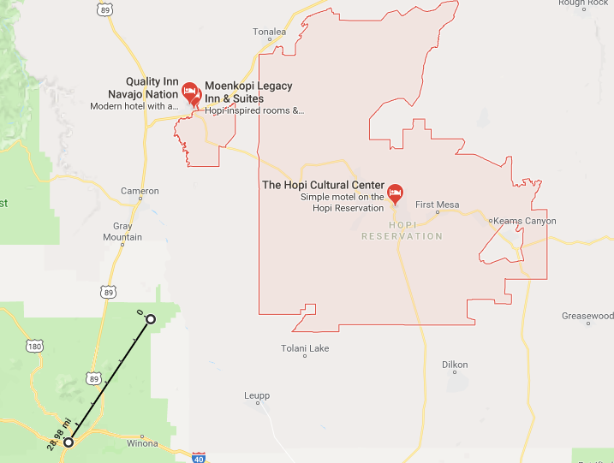


Hopi Nation
Keams Canyon
Wupatki Natl. Monument
Fig. 1 Map of present day Hopi Nation

Slide 3
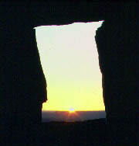
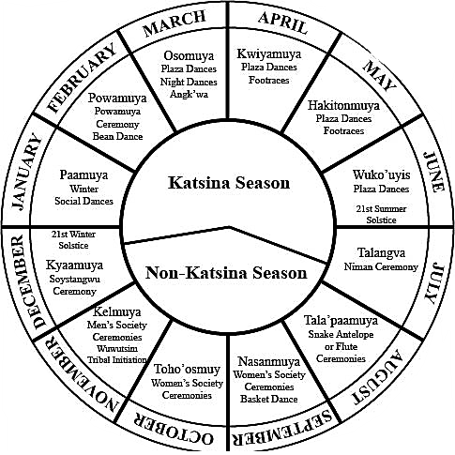
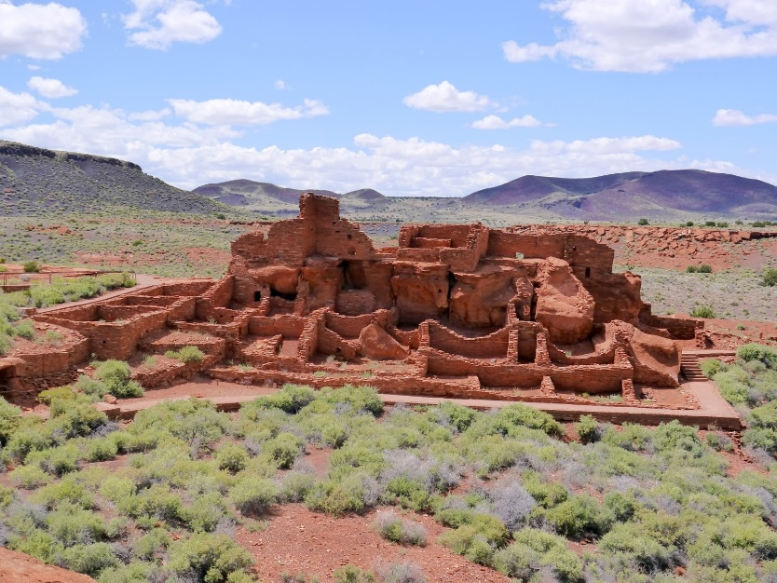
Wupatki National Monument
1,100 and 1,300 AD, pre-Colombian culture
Members of the Anasazi People at Crack N’ Rock community , an east sloping mesa
This site is thought to be where the Katsina began for the present day Hopi people and Culture
The site at Crack N’ Rock community marks the Winter Solstice, the Water Clan then announces the Powamu Ceremony
Dry farming agricultural practices
How will climate change challenge these centuries old ceremonial practices?
Fig. 3 East Facing Wall at Crack N’ Rock Community
Fig. 2 Hopi Ceremonial Calendar
Fig. 4 Wupatki National Monument

Slide 4
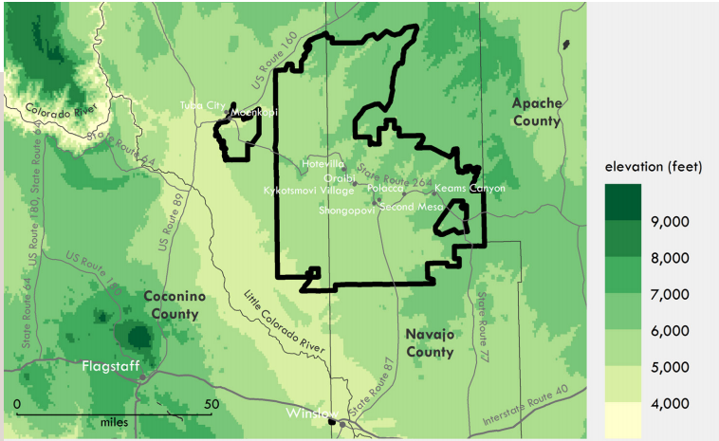
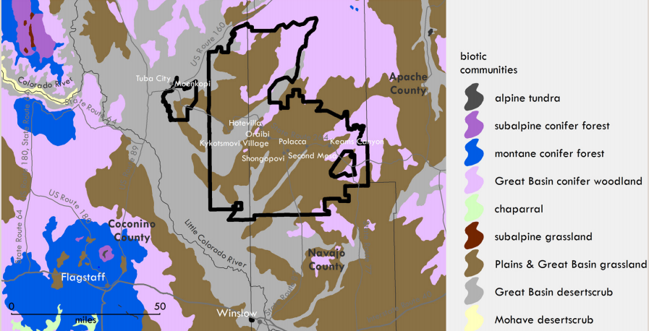
Present Day Hopi Nation and Culture
Mixed Pinyon-Juniper grassland environment, arid conditions.
Variability in precipitation amounts.
Variability of temperature extremes.
Drought conditions persist most of the year.
Variability has been attributed to altitude changes across the nation.
Reliance on dry farming
Precipitation Evapotranspiration rates for Keams Canyon are at 52 inches per year. Keams canyon on average receives 11 inches of rain per year.

Slide 5
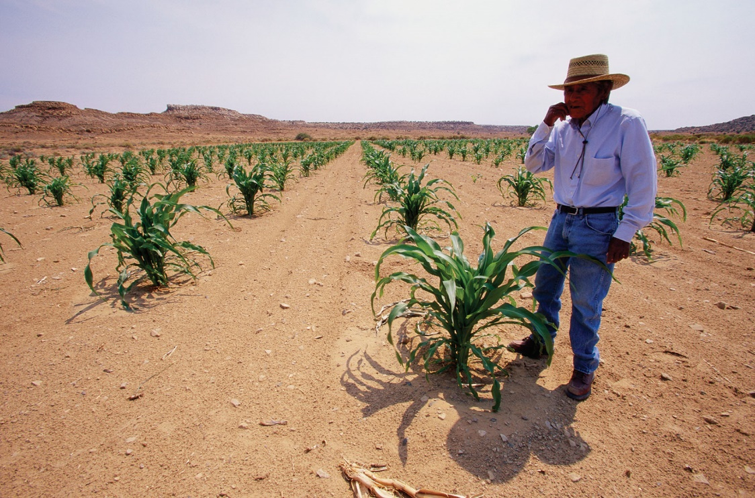
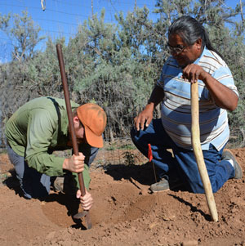
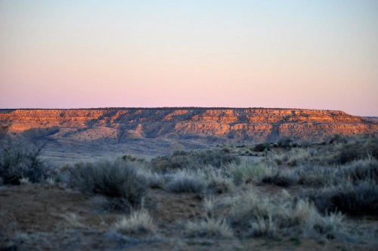
Dry Farming

Slide 6
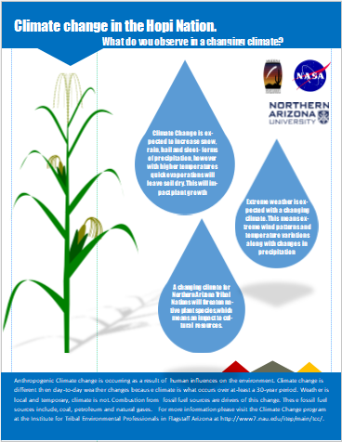
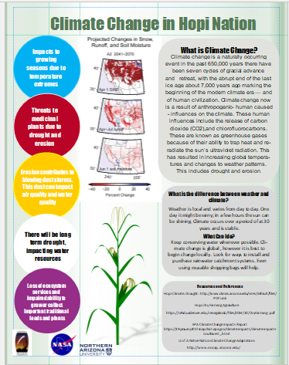
Outcomes of the Project
Create awareness of climate change adaptation and mitigation efforts within Hopi communities
Fact sheets identifying potential impacts to the Hopi Nation
Educational Outreach to Community Events : conservation games, climate education focused games, distribution of fact sheets
Outreach to local schools
Educational outreach dispersed through out Hopi communities.

Slide 7
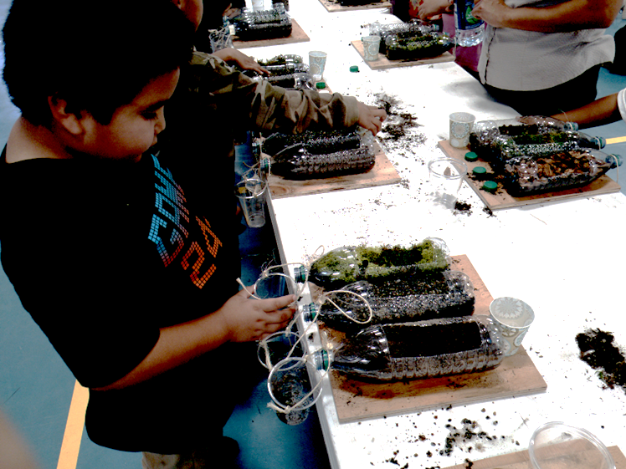
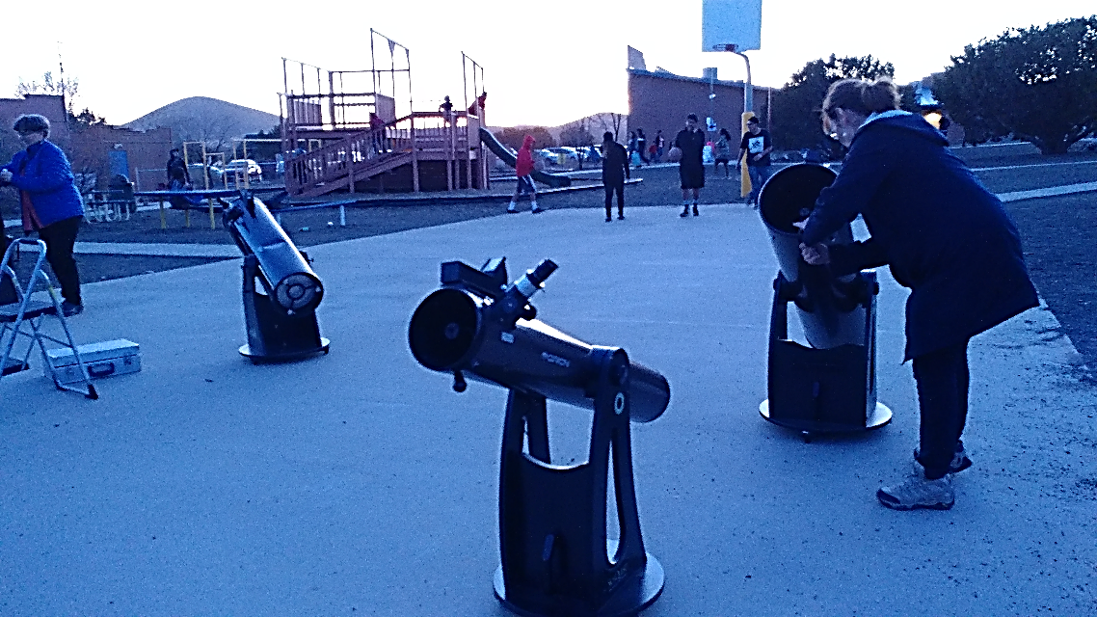
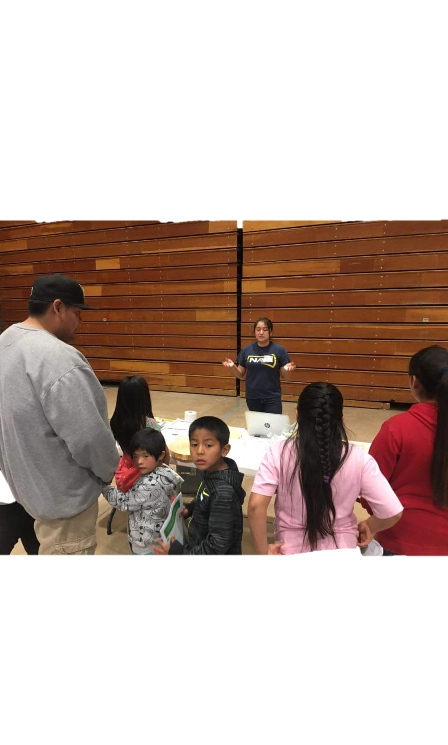
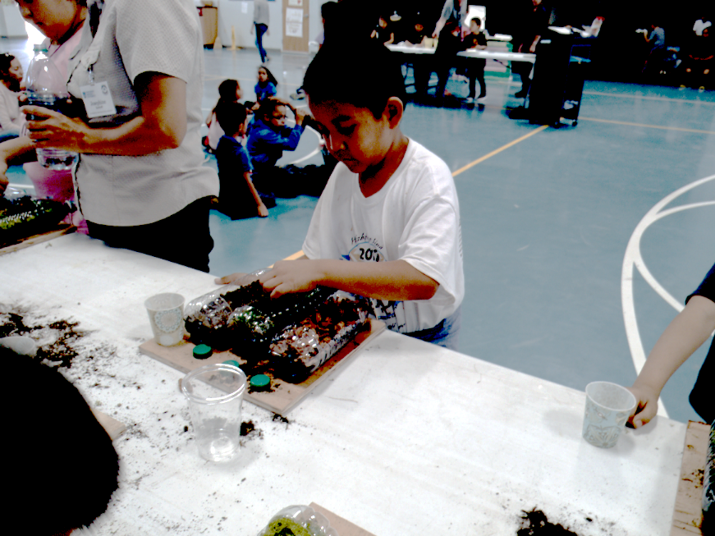
Outreach to local schools

Slide 8
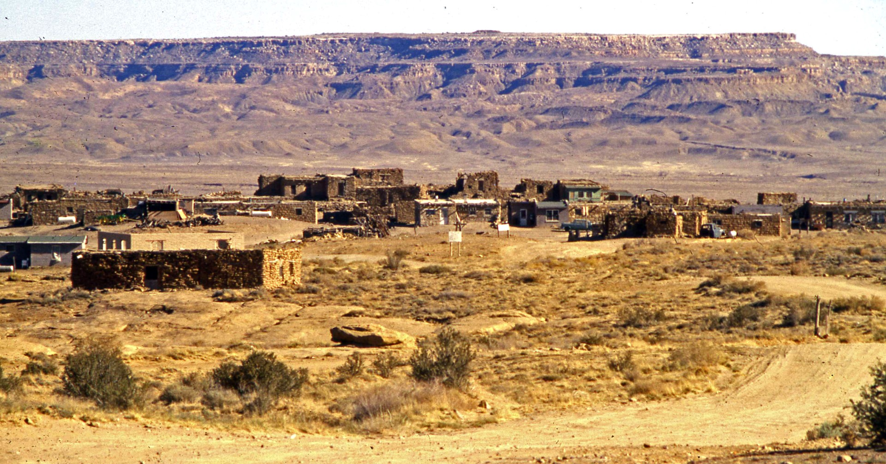

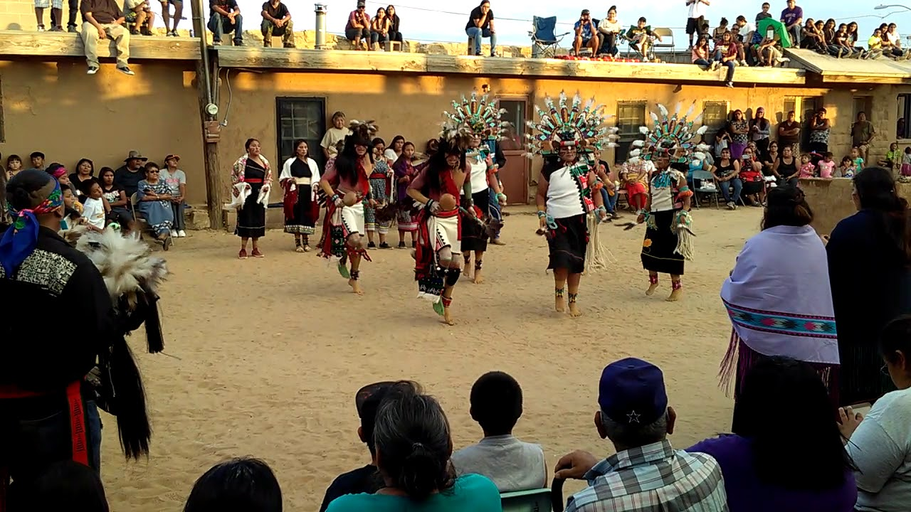
Conclusions
Outreach Conducted should use indigenous methodologies to connect community to resources
Outreach to local schools will need to continue
More community outreach events should be conducted
More resource sheets need to be distributed to through out the community
Long-term community planning for climate change adaptation and mitigation should be considered

Slide 9
Acknowledgements
Mansel Nelson, Institute for Tribal Environmental Professionals
NASA Space Grant Program
Arizona Space Grant consortium
Paula Lopez, Hopi Telecommunications Inc.
Shawn Namoki Hopi Substance Abuse Prevention Project
Bryan Bates, Emeritus Professor of Science, Coconino Community College Naturalist: Lindblad Expeditions/ National Geographic; Grand Canyon Association Field Institute; Betchart Expeditions; Smithsonian Expeditions; Road Scholars

